Slide 1
Vulnerability Scanner:
Web Application Vulnerability Scanners are automated tools that scan web applications, normally from the outside, to look for security vulnerabilities such as Cross-site scripting, SQL Injection, Command Injection, Path Traversal and insecure server configuration. This category of tools is frequently referred to as Dynamic Application Security Testing (DAST) Tools. A large number of both commercial and open source tools of this type are available and all of these tools have their own strengths and weaknesses. If you are interested in the effectiveness of DAST tools, check out the OWASP Benchmark project, which is scientifically measuring the effectiveness of all types of vulnerability detection tools, including DAST.
Source: testasp.vulnweb.com
Vulnerability Scanning performed with the help of:
1. Sqlmap
2. Burpsuite – XSS
3. Nmap

Slide 2
Source : testasp.vulnweb.com
Sqlmap : sqlmap is an open source penetration testing tool that automates the process of detecting and exploiting SQL injection flaws and taking over of database servers. It comes with a powerful detection engine, many niche features for the ultimate penetration tester and a broad range of switches lasting from database fingerprinting, over data fetching from the database, to accessing the underlying file system and executing commands on the operating system via out-of-band connections.
Step 1: visit testasp.vulnweb.com
Step 2: copy the domain name
Step 3: Go to kali linux and try to ping the domain
Step 4: Will be able to get the ip address.
Step 5: Now to try find vulnerability with the help of sqlmap using that ip
Step 6: the following sqlmap performed:
1. sqlmap –u <url> --crawl 3
2. sqlmap –u <url> --crawl 3 –technique=“U” –batch
3. sqlpmap –u <url> --crawl 3 –batch –risk 3
4. sqlmap –u<url> -all
Mitogation For sql injection:
Option 1: Use of Prepared Statements (with Parameterized Queries)
Option 2: Use of Properly Constructed Stored Procedures
Option 3: Allow-list Input Validation
Option 4: STRONGLY DISCOURAGED: Escaping All User Supplied Input

Slide 3
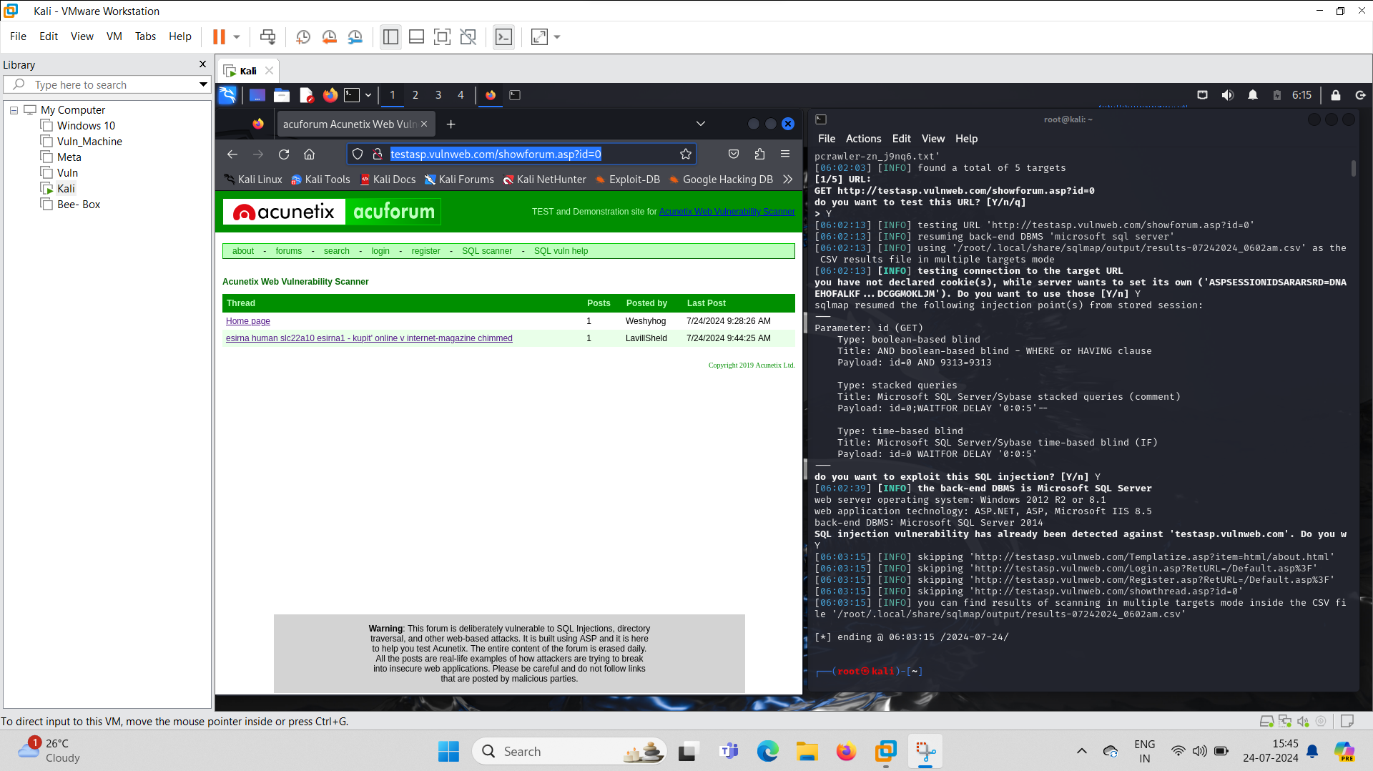
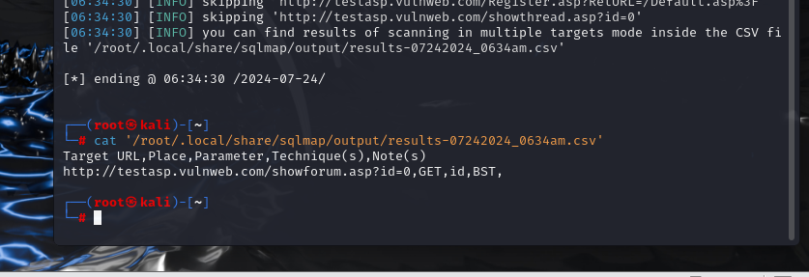
Performed sql-map to find vulnerability
1.Boolean based blind injection
2.Stacked Queries
3.Time based blind injection
[sqlmap –u <url> --crawl 3]

Slide 4
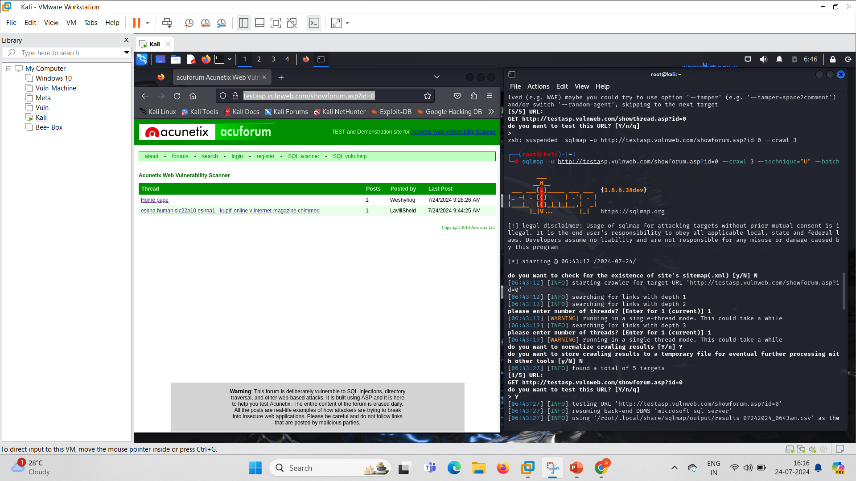
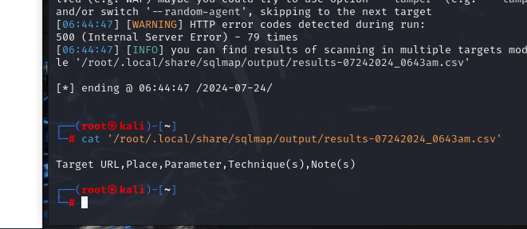
Performed Union based sql-injection
Sqlmap –u <url> --crawl 3 –technique=“U” --batch

Slide 5

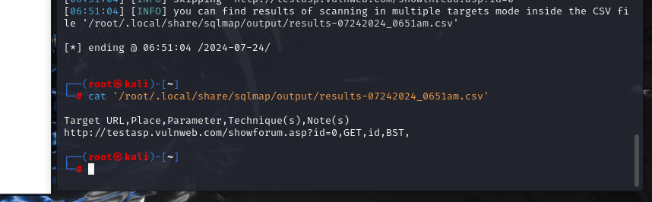
Risk factor
Sqlpmap –u <url> --crawl 3 –batch –risk 3

Slide 6
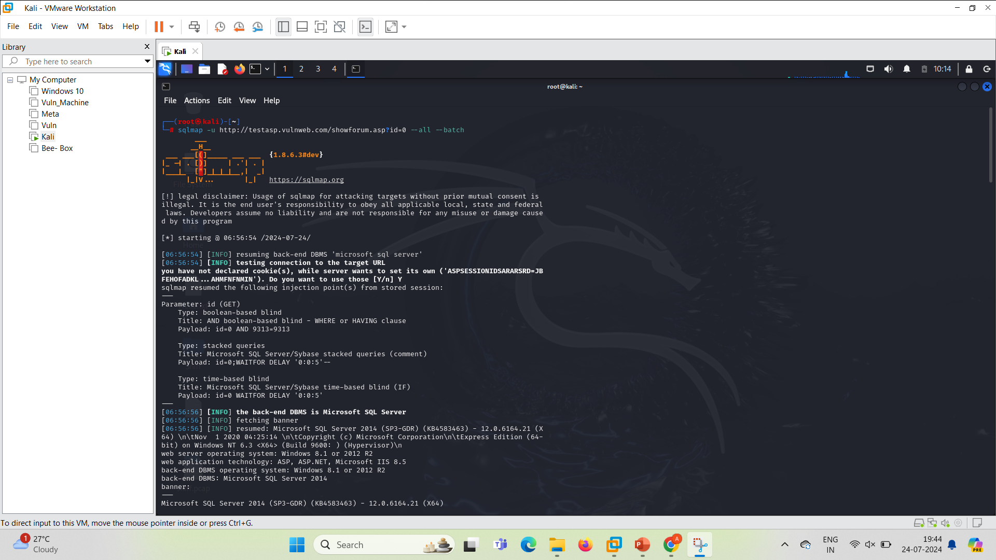
Sqlmap for finding complete vunlernability
[ sqlmap –u<url> -all]

Slide 7
Source: testasp.vulnweb.com
XSS: Cross-Site Scripting (XSS) attacks are a type of injection, in which malicious scripts are injected into otherwise benign and trusted websites. XSS attacks occur when an attacker uses a web application to send malicious code, generally in the form of a browser side script, to a different end user. Flaws that allow these attacks to succeed are quite widespread and occur anywhere a web application uses input from a user within the output it generates without validating or encoding it.
Step 1: Visit Testaspvulweb.com
Step 2: Turn on your burp suite
Step 3: On the intercept and access the site
Step 4: send the request to intruder
Step 5: import the payload
Step 6: explore the vulnerability
Step7: try to exploit
Mitigation For XSS:
Whenever possible, prohibit HTML code in inputs.
Validate inputs.
Secure your cookies. .
Sanitize data. Use a web application firewall (WAF).

Slide 8
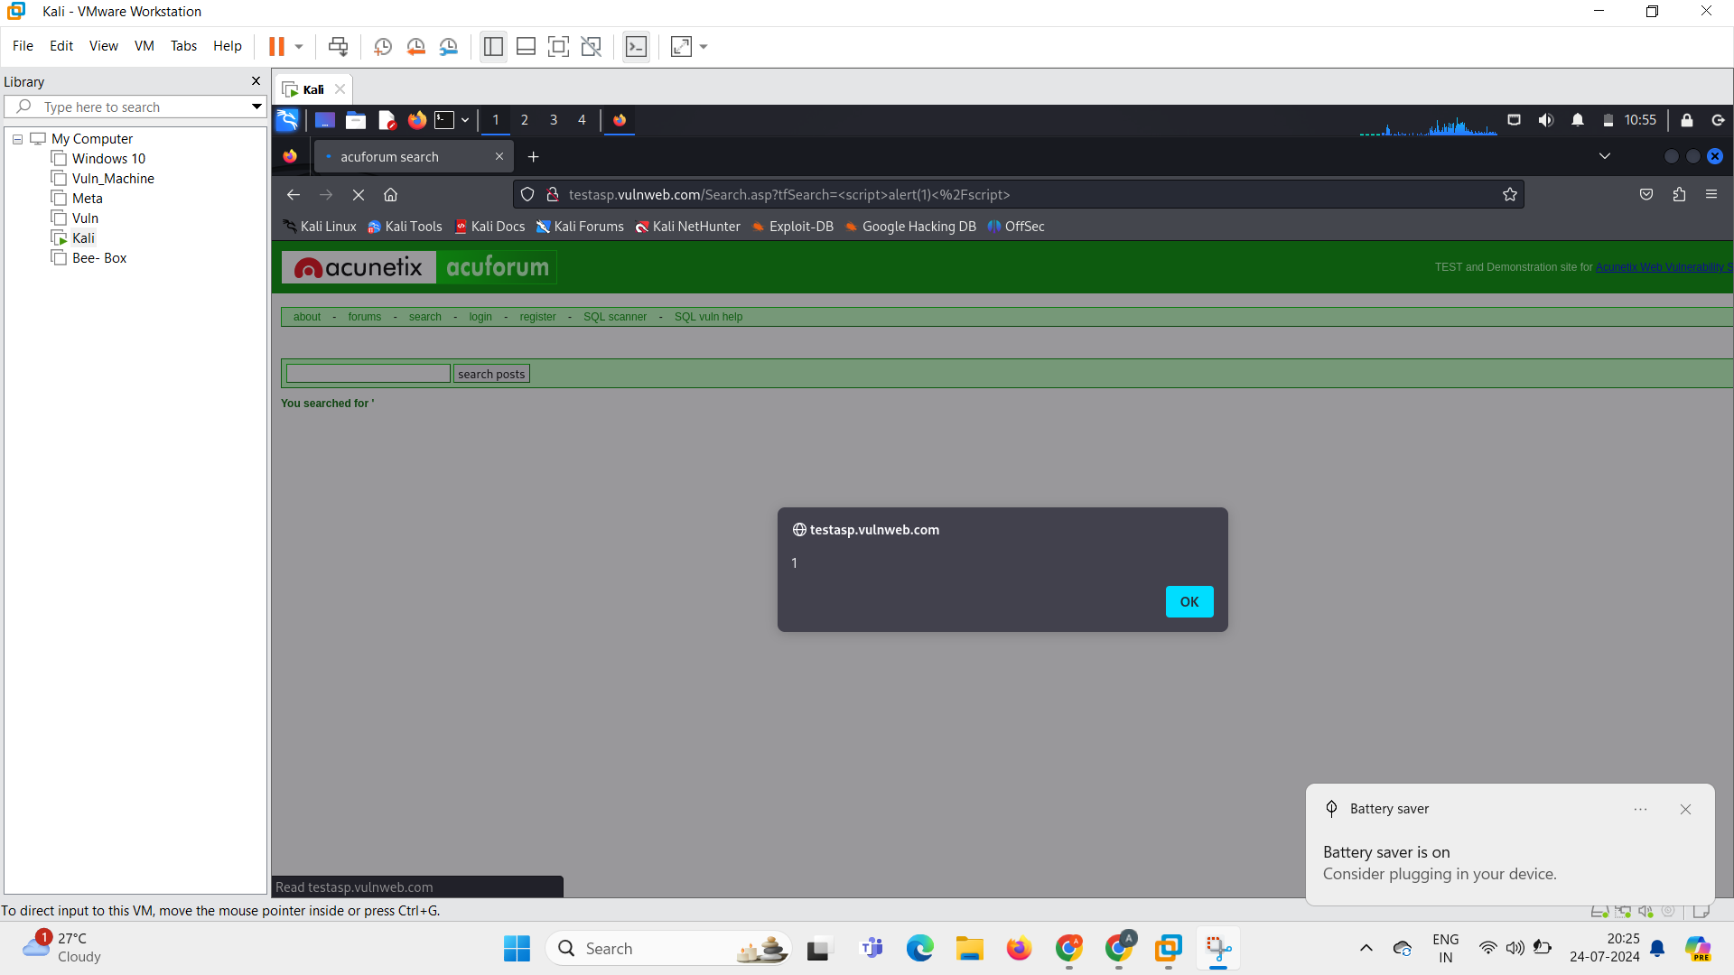
Injected some scripts to check the vulnerability., and found reflected xss

Slide 9
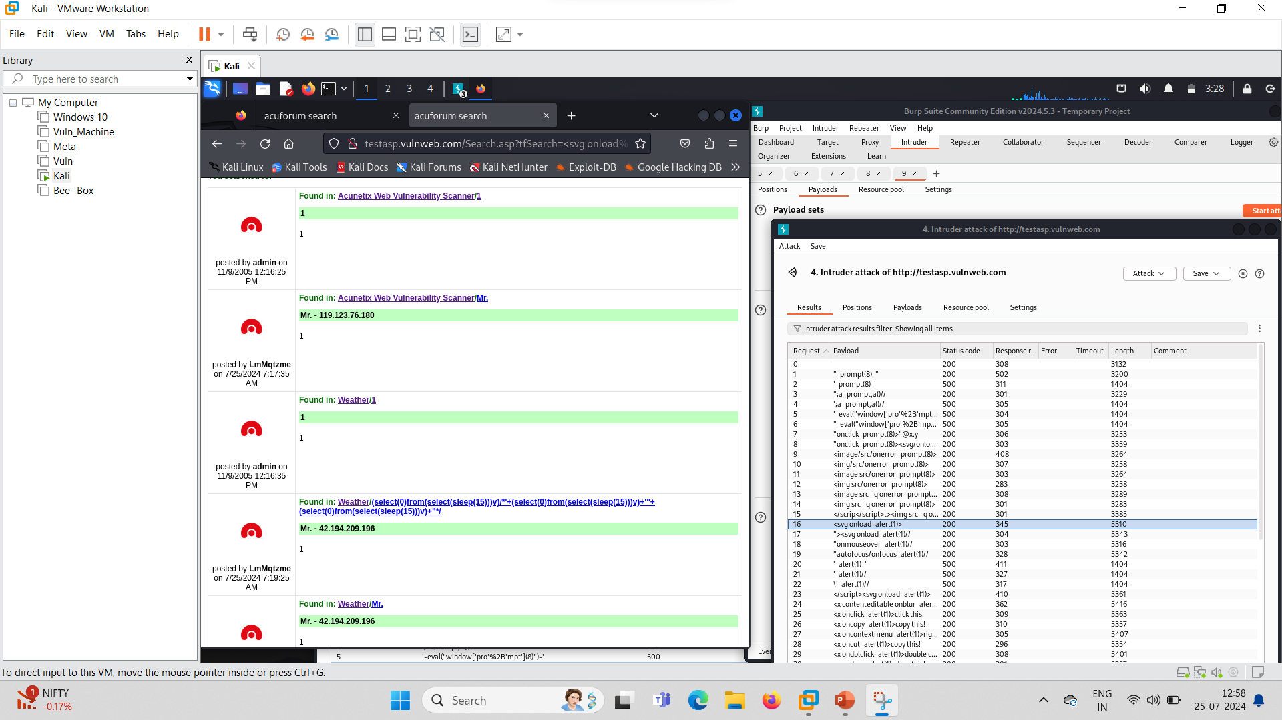

Slide 10
Source : testasp.vulnweb.com
Nmap: Nmap is short for Network Mapper. It is an open-source Linux command-line tool that is used to scan IP addresses and ports in a network and to detect installed applications.
Step 1: find the ip address with help of domain name
Step 2: now perform nmap scanning to discover, open ports, active host, version of particular port, vulnerable ports
Step 3: Nmap following scan:
1. nmap <ip>
2. nmap -p- -O <ip>
3. nmap –A <ip>

Slide 11
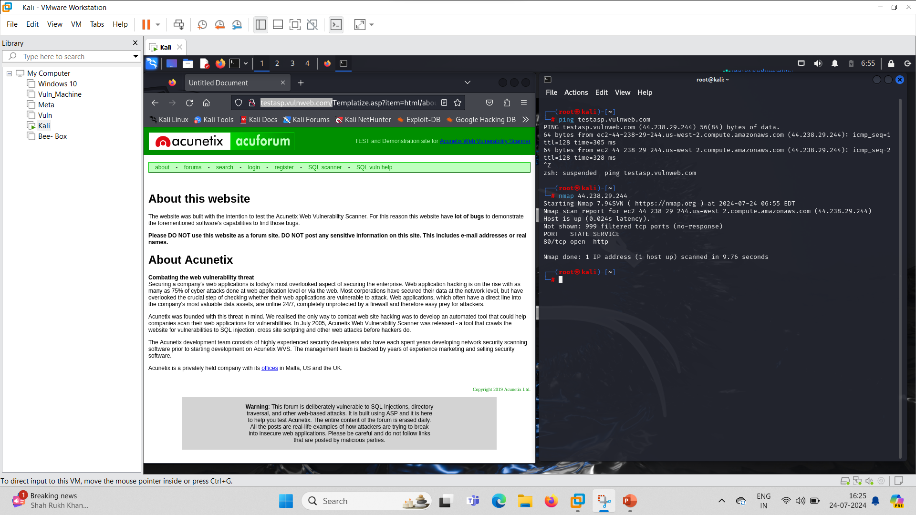
Performed nmap scanning to find vulnerabilities, found the host is up.
nmap <ip>

Slide 12
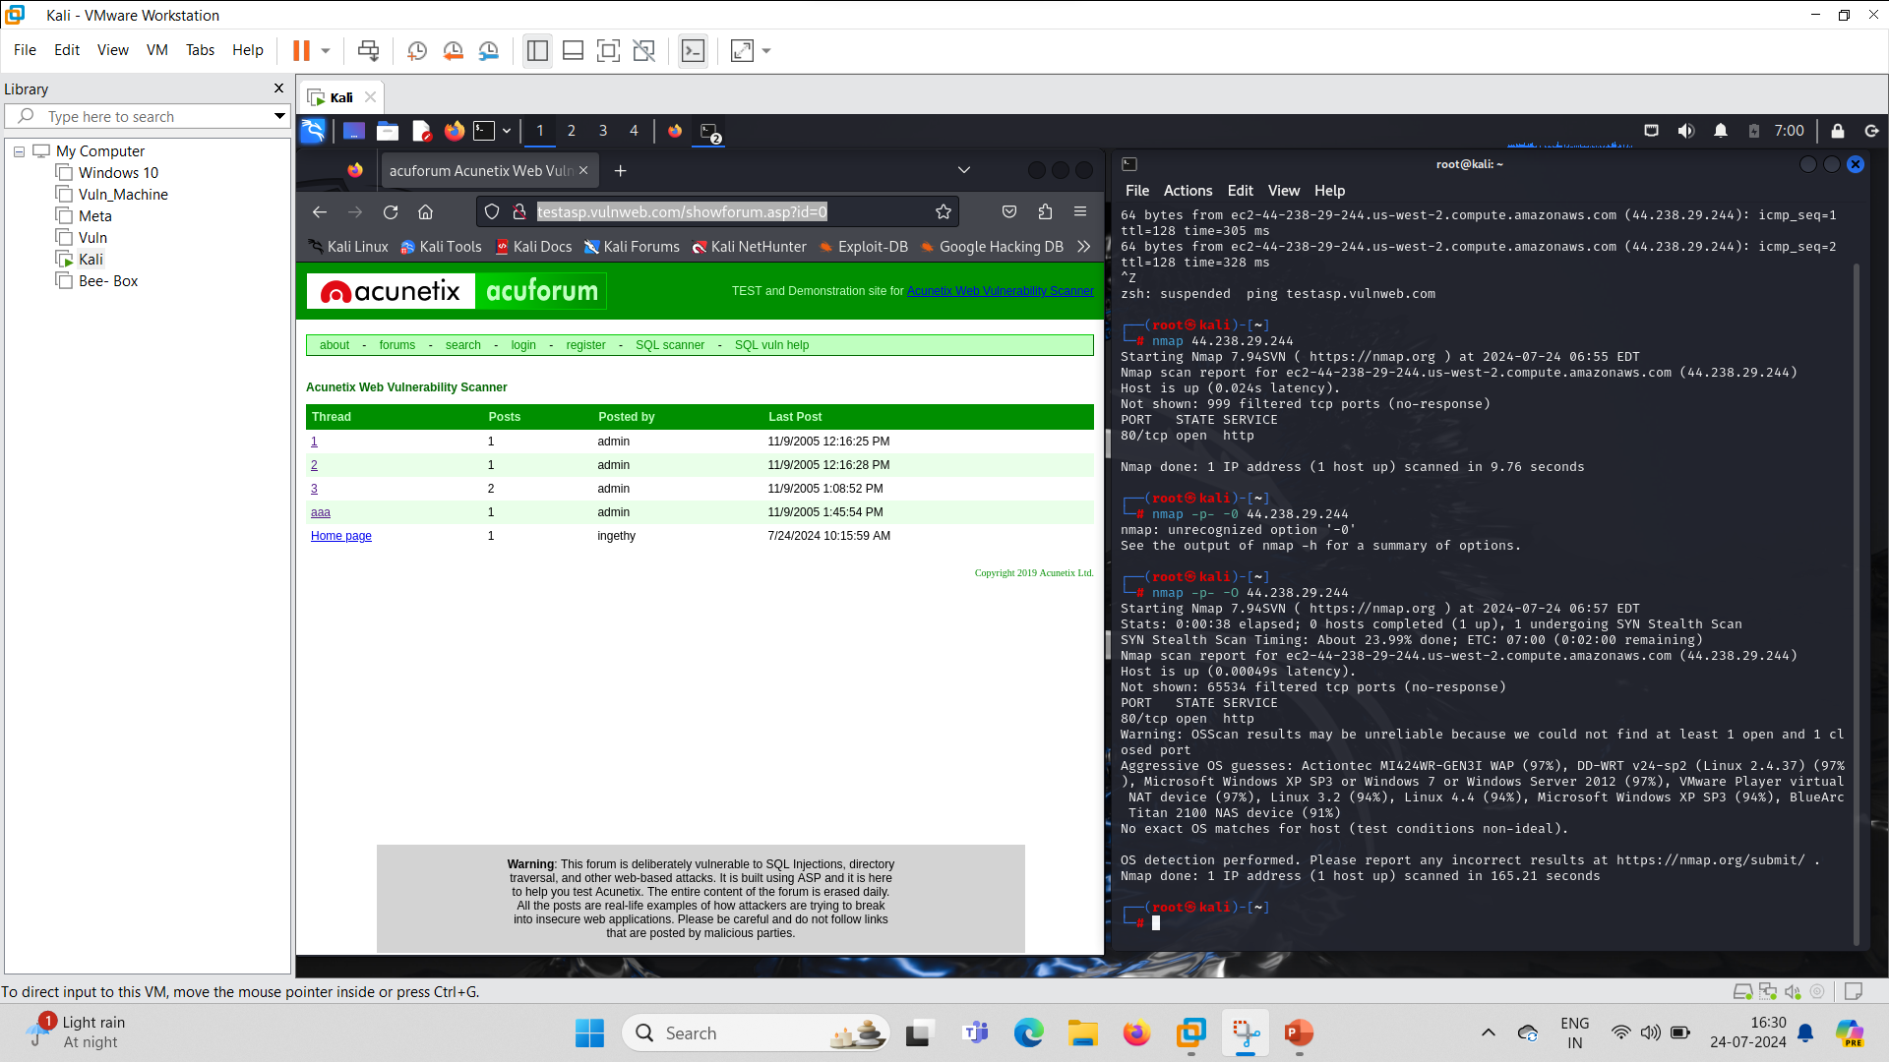
Performed all scan port, and got 1 port open and performed os detection.
nmap -p- -O <ip>

Slide 13
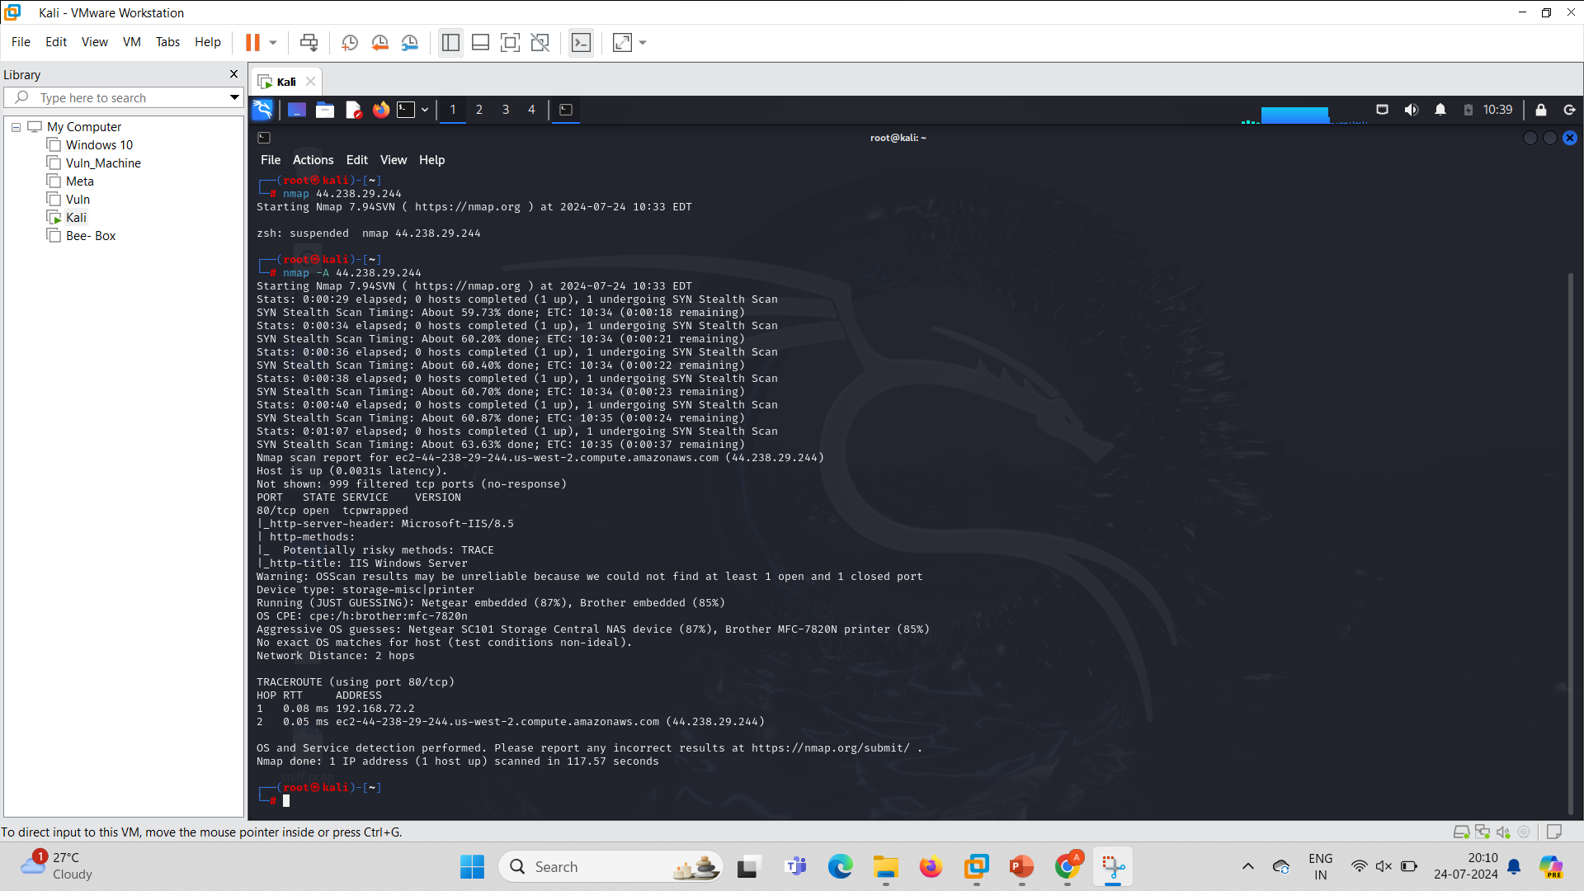
Performed aggressive scan using nmap
nmap –A <ip>

